Slide 1
CNN
Convolutional Neural Networks (CNN) becomes one of the most appealing approaches recently

Slide 2
Paper name
Global Journal of Computer Science and Technology: D Neural & Artificial Intelligence

Slide 3
Publisher Name:
Global Journals
Publishing Year : 2019

Slide 4
Name of the author
MD. Anwar Hossain
Hossain was a freedom fighter of the Bangladesh Liberation War of 1971 during which he served as a staff officer of sector 11.

Slide 5
a) The Architecture of the Proposed Model
We design Convolutional Neural Network to recognize visual patterns directly from pixel images with minimal preprocessing. Almost all CNN architectures follow the same general design principles of successively applying convolutional layers to the input, periodically downsampling (Max pooling) the spatial dimensions while increasing the number of feature maps. Moreover, there are also fully connected layers, activation functions and loss function (e.g., cross entropy or softmax). However, among all the operations of CNN, convolutional layers, pooling layers, and fully connected layers are the most important ones

Slide 6
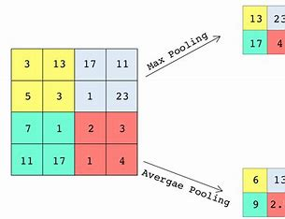
.
When constructing CNN, it is common to insert pooling layers after each convolution layer, so that we can reduce the spatial size of the representation. This layer reduces the parameter counts, and thus reduces the computational complexity. Also, pooling layers help with the overfitting problem. We select a pooling size to reduce the amount of the parameters by selecting the maximum, average, or sum values inside these pixels

Slide 7
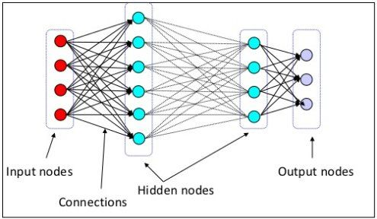
.
A fully connected network is in any architecture where each parameter is linked to one another to determine the relation and effect of each parameter on the labels. We can vastly reduce the time-space complexity by using the convolution and pooling layers. We can construct a fully connected network in the end to classify our images.

Slide 8
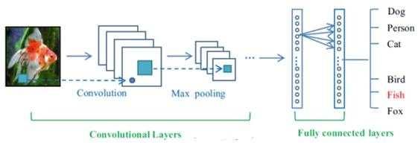
.
Overview look of our proposed convolutional neural network. It is very much similar to the other image recognition architectures [1,2,3,4] but has changed in the number of filters, neurons and activation functions for better performance. We can divide our model into six sequences of layers.

Slide 9
b) Explanation of the Model
At first, we need some pre-processing on the images like resizing images, normalizing the pixel values, etc. After the necessary pre-processing, data is ready to be fed into the model.

Slide 10
Layer-1 consists of the convolutional layer with ReLu (Rectified Linear Unit) activation function which is the first convolutional layer of our CNN architecture. This layer gets the pre-processed image as the input of size n*n=32*32. The convolutional filter size (f*f) is 5*5, and the number of filters is 32. After this convolution operation, we get feature maps of size 32*28*28 where 32 is the number of feature maps which is equal to the number of filters used, and 28 comes from the formula ((n+2p-f)/s) +1= ((32+2*0- 5)/1) +1=28. Then the ReLu activation is done in each feature map.

Slide 11
Layer-2 is the max pooling layer. This layer gets the input of size 32*28*28 from the previous layer. The pooling size is 2*2. After this max pooling operation, we get feature maps of size 32*14*14. Max pooling is done in each feature map independently, so we get same number feature maps as the previous layer, and 14 comes from the same formula ((n+2p-f)/s) +1. This layer has no activation function.

Slide 12
Layer-3 is the second convolutional layer with ReLu activation function. This layer gets the input of size 32*14*14 from the previous layer. The filter size is 5*5, and the number of filters is 32. After this convolution operation, we get feature maps of size 32*10*10. Then ReLu activation is done in each feature map.

Slide 13
Layer-4 is the max pooling layer. This layer gets the input of size 32*10*10 from the previous layer. The pooling size is 2*2. After this max pooling operation, we get a feature map of size 32*5*5

Slide 14
Layer-5 is the third convolutional layer with ReLu activation function. This layer gets the input of size 32*5*5 from the previous layer. The filter size is 4*4, and the number of filters is 64. After this convolution operation, we get feature maps of size 64*1*1. This layer acts as a fully connected layer and produces a one-dimensional vector of size 64 by being flattened.

Slide 15
Layer-6 is the last layer of the network. It is a fully connected layer. This layer will compute the class scores, resulting in a vector of size 10, where each of the ten numbers corresponds to a class score, such as among the ten categories of CIFAR-10 dataset. For final outputs, we use the softmax activation function.

Slide 16
Implementation
Preparing the data is the first step of our approach. Before we build the network, we need to set up our training and testing data, combine data, combine labels and reshape into the appropriate size. We save the dataset of normalized data.

Slide 17
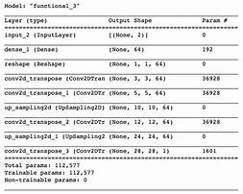
.
we can build our CNN by creating each layer individually as shown in fig 5. Afterward, we will invoke objective and error layers that will provide a graphical visualization of the training and validation convergence after completing each epoch. MatconvNet initializes the weights by using Gaussian distribution.

Slide 18
Results and Discussion
Training set size affects the accuracy increases as the number of data increases. The more data in the training set, the smaller the impact of training error and test error and ultimately the accuracy can be improved.

Slide 19
Conclusion and Future Work
Here we demonstrate a model which can recognize and classify the image. Later it can be extended for object recognition, character recognition, and real-time object recognition. Image recognition is an important step to the vast field of artificial intelligence and computer vision. As seen from the results of the experiment, CNN proves to be far better than other classifiers. The results can be made more accurate by increasing the number of convolution layers and hidden neurons. People can recognize the object from blurry images by using our model. Image recognition is an excellent prototype problem for learning about neural networks, and it gives a great way to develop more advanced techniques of deep learning. In the future, we are planning to develop a real-time image recognition system.

